Slide 1
Tutorial 2

Slide 2
Question 1: Add the binary numbers. (a) 11.111 and 11 (b) 11010111 and 01010001 Question 2: Subtract the binary numbers (a) 11010 – 10111 (b) 10110010 – 111101 Question 3: Multiply the binary numbers (a) 10111 × 110010 (b) 11001 × 1011011 Change to decimal to confirm the answers. Question 4: Perform the binary division (a) 100111010 ÷ 1101 (b) 111010011 ÷ 11011 Change to decimal to confirm the answers. Question 5: Convert the following numbers to BCD: (a) 42 (b) 872.8
Question 6: Convert the following numbers to their BCD equivalents. (a) 10101102 (b) 1100100.112
Question 7: Add the following BCD numbers. (a) 01100100 + 00110011 (b) 100101111000 + 100101010001
Question 8: Convert the binary to Gray code. (a) 10110 (b) 11000110
Question 9:

Slide 3
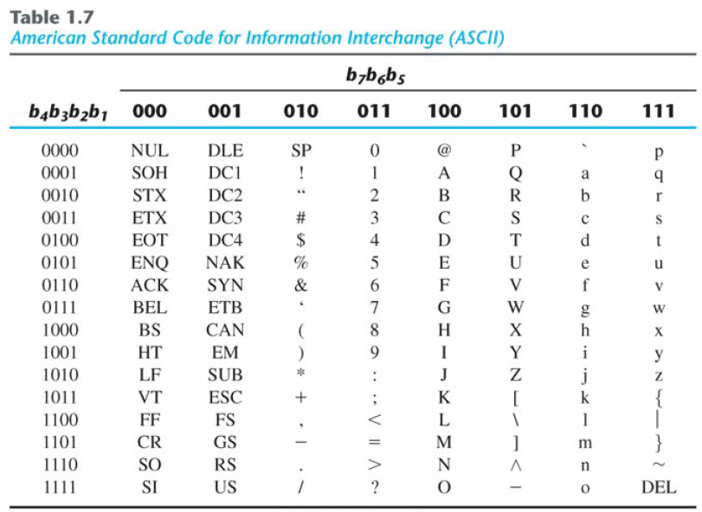
ASCII Code
*Get More information on:
ASCII code
EBCDIC code and
Unicode

